Slide 1
Localization of passive house construction
Oh, Dae-seok
Passive House Institute Korea

Slide 2
Introduction
Carbon neutral & Zero energy building
Korea declaration of net zero in 2050
Energy Zero Building
Localization
Climate
South Window
Shading
Envelope U-value
Thermal Storage
Lifestyle
Zero Energy Building - EDC

Slide 3
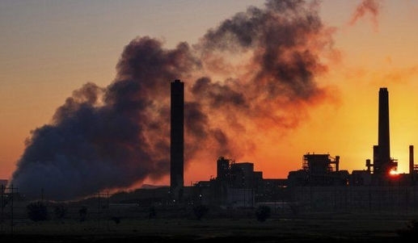
2050
carbon neutral
2019.09 EU declaration of net zero in 2050
2020.09.22 Declaration of carbon neutrality in China in 2060
2020.10.26 Japan declared net zero in 2050
2020.10.28 Korea declaration of carbon neutrality in 2050

Slide 4
Korea declaration of net zero in 2050
ZEB Responsibility & Want
01
Global problem
The damage caused by climate change is estimated to increase to 20% of global GDP annually
02
Country - Energy Policy
Push!! Push!!
40% reduction compared to 2018, the peak emission level (4.17%/year reduction) 2050 Net zero
03
Industry Development
Develop new market in the field of construction and foster new and renewable energy industry
Developing overseas market by improving international competitiveness
04
Personal - Reduce energy costs / Ensure a comfortable living environment
Responding to rising energy costs
It is possible to secure a healthy and pleasant living environment

Slide 5
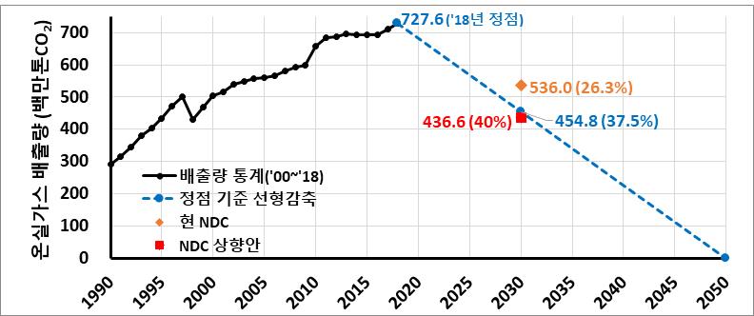
Korea declaration of net zero in 2050
Korea declaration of net zero in 2050
Greenhouse gas reduction roadmap -2021
Greenhouse gas emissions (million tons CO2)
(Emission Statistics ‘00~’18)
(Linear reduction by vertex)
(NDC current plan)
(NDC upgrade plan)
⇒ (NDC raised level) 40% reduction compared to 2018, the peak emission level (4.17%/year reduction)
Source: 2030 National Greenhouse Gas Reduction Target (NDC) Upgrade Plan – 2021-10-18 / Jointly distributed data with related ministries
Notes:
정부의 제로에너지 건축 인증 범위 확대 및 에너지 성능기준 강화 배경
온실가스 감축 로드랩 수정으로 건물 부분의 감축률 상향
- 신축건축물 에너지 기준 강화 - 기존 건축물 그린리모델링 활성화

Slide 6
Korea declaration of net zero in 2050
Korea declaration of net zero in 2050
Greenhouse gas reduction roadmap (Architecture part)
- Improve energy efficiency
Expansion of zero-energy building that minimizes energy consumption and green remodeling that improves energy efficiency of old buildings
- Supply of high-efficiency equipment, demand management
Promoting the distribution of high-efficiency devices such as lighting and home appliances, strengthening energy efficiency standards, and strengthening energy demand management
- Smart Energy Management
Installation of sensors and measuring equipment in air conditioning/heating ventilation, lighting, hot water supply, etc., and introduction of real-time automatic energy control system in connection with communication network
- Expanding the supply of clean energy
Expand the supply of new and renewable energy such as solar, geothermal, and water heat, improve the efficiency of district heating heat supply, electrify equipment using fossil fuels, etc.
Source: 2030 National Greenhouse Gas Reduction Target (NDC) Upgrade Plan – 2021-10-18 / Jointly distributed data with related ministries
Notes:
정부의 제로에너지 건축 인증 범위 확대 및 에너지 성능기준 강화 배경
온실가스 감축 로드랩 수정으로 건물 부분의 감축률 상향
- 신축건축물 에너지 기준 강화 - 기존 건축물 그린리모델링 활성화

Slide 7

?
Zero energy building

Slide 8
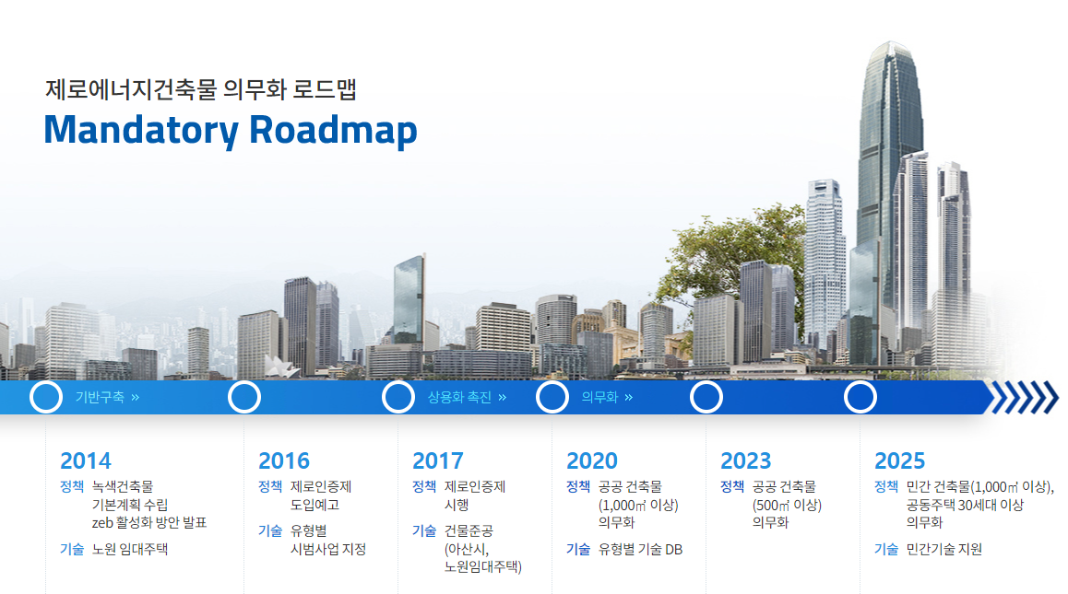
Government's zero energy building certification system
Zero energy building mandatory roadmap
- Establishment of basic green building plan
Announcement of ZEB
- Activation plan
Nowon rental housing pilot project
- Notice of introduction of zero certification system
- Designation of pilot projects by type
- Implementation of zero certification system
- Pilot project completed
- Mandatory for public buildings
more than 1000 square meters
- Technology DB by type
- Mandatory for public buildings
500 square meters or more
- Mandatory for private buildings
(more than 1000 square meters, 30 or more apartment houses)
- Private technology support

Slide 9
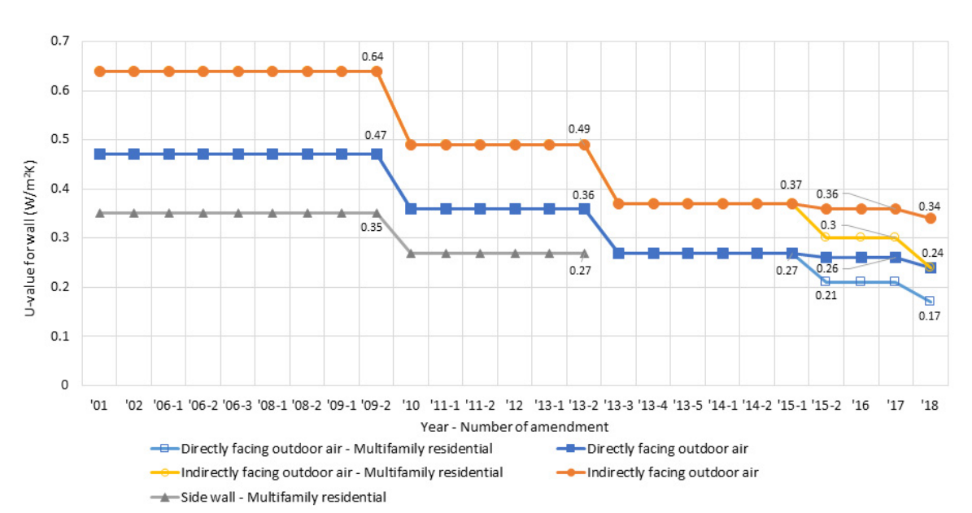
Government's zero energy building certification system
Preparation of legal basis
Changes in legal insulation performance according to the roadmap
Announcement
of ZEB

Slide 10
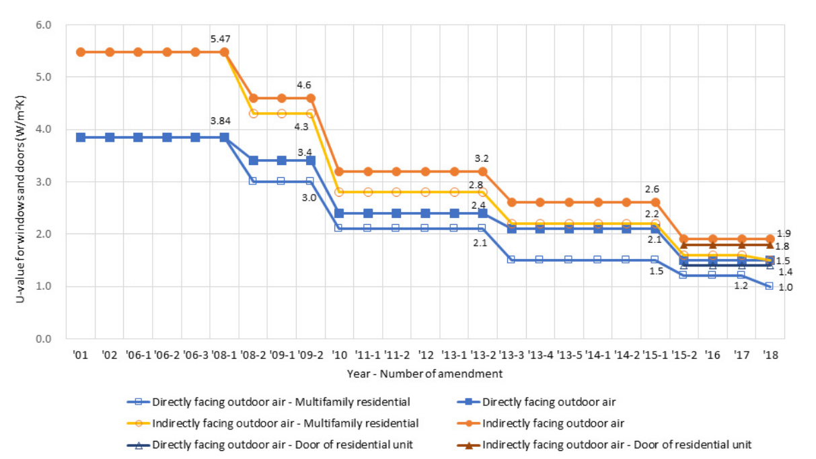
Government's zero energy building certification system
Preparation of legal basis
Changes in legal window and door U-value according to the roadmap
Announcement
of ZEB

Slide 11
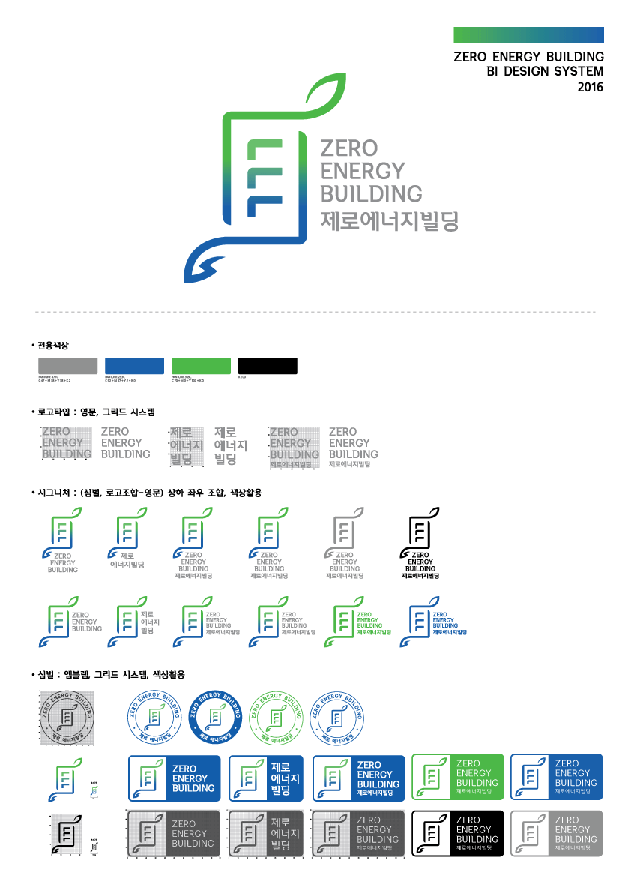
Government's zero energy building certification system
Zero energy building certification
Zero Energy Building Certification System
- 2020 in public sector
- 2025 in private sector
Minimum requirement
Building energy efficiency 1++ (Residential > 90 kWh/㎡a Non-residential > 140 kWh/ ㎡a)
Energy independency over 20%
BEMS

Slide 12
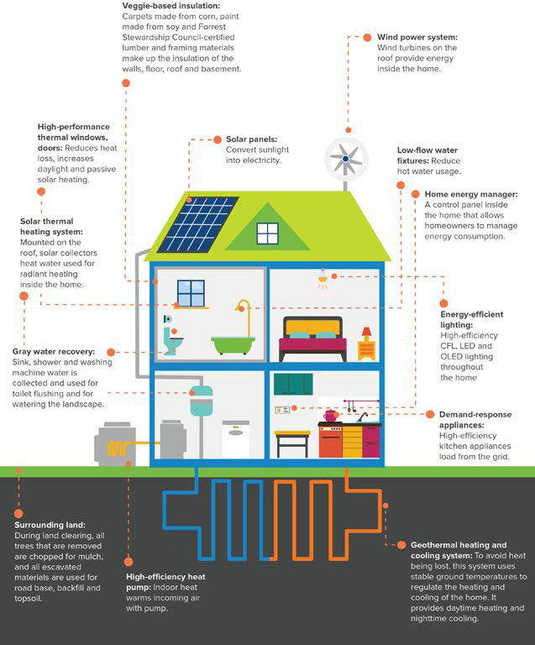
Technical point of a zero-energy building
Balance between active and passive
Active
Solar power
/ solar hot water system
High efficiency
equipment
Geothermal systems
LED
Bio energy
Passive
High insulation
Heat exchange ventilation
Air tightness
System
window
External awning

Slide 13
Technical point of a zero-energy building
Optimum Mixing?
Area, height and tax reduction
Increased Valuation Amount, Low Interest Loans
Build Cost
incentive
Client budget
passive
Minimum of passive technology
High efficiency
equipment
active
Optimization
is a combination of factors
that meet the target performance
with minimal cost.
Renewable
energy

Slide 14
Technical point of a zero-energy building
Minimum of passive technology
01
Thermal comfort
it should satisfy KS A ISO 7730’s thermal comfort such as PMV, PPD, discomfort air flow.
02
Anti-condensation and mold
KS F 2295, Simulation: ISO 15099, KS L ISO 13788 Temperature and humidity performance of building components Critical surface humidity and internal surface temperature calculation to prevent internal condensation
03
sufficient amount of ventilation
Korea should require the installation of mechanical ventilation for buildings over a certain size and ensure 0.5 ventilation per hour for internal carbon dioxide concentration and pollutant emissions.

Slide 15
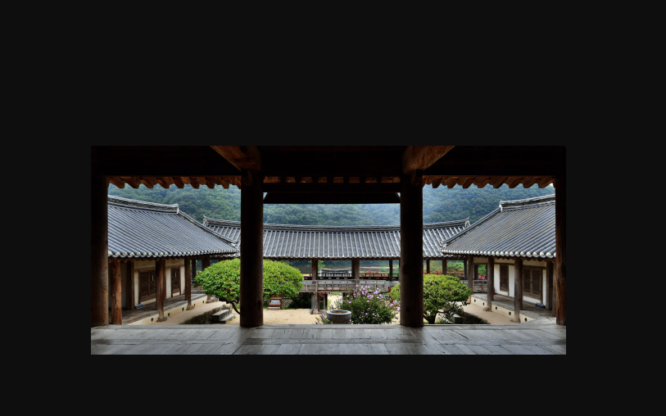
Localization

Slide 16
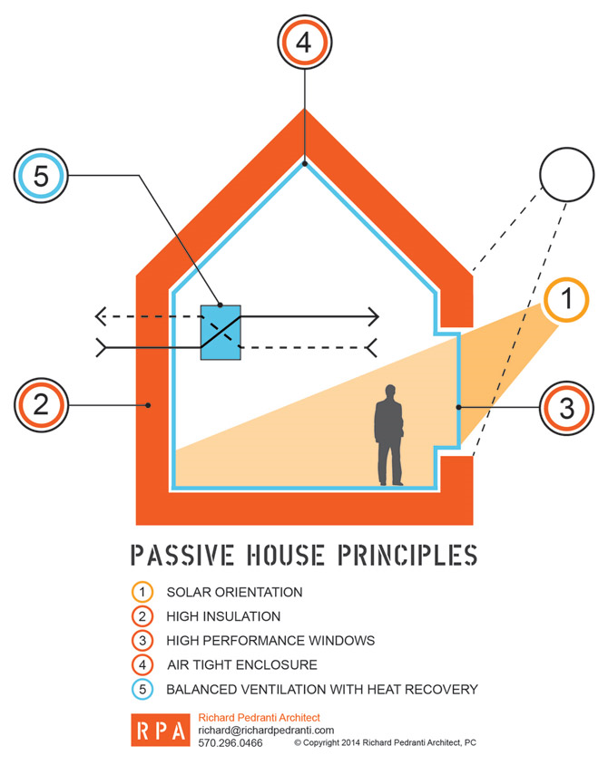
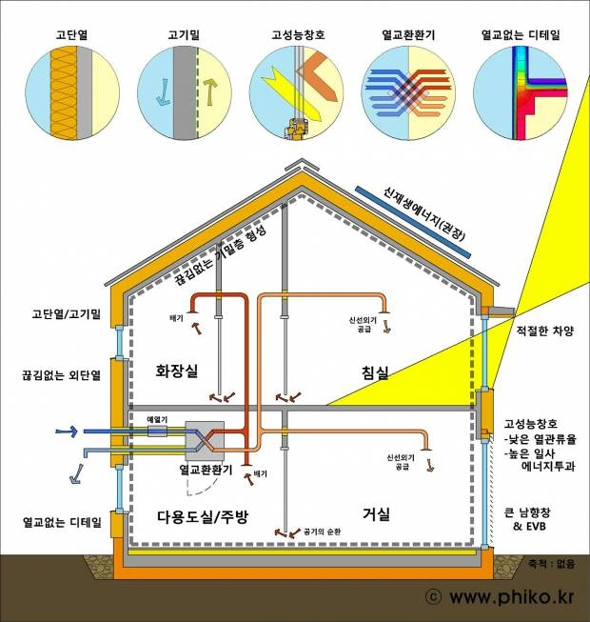
Localization of passive house
PHI Passive House standards (Germany)
- Heat Demand : ≤ 15 kWh/(m²a)
- or Peak Heating Load : ≤ 10 W/m²
- Primary Energy Consumtion : ≤ 120 kWh/(m²a)
- Air Tightness (50pa) : ≤ 0.6 /h
Source : Richard Pedranti Architect

Slide 17
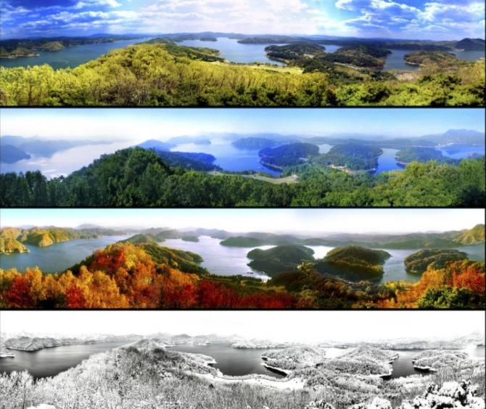
Localization of passive house - climate
Climate

Slide 18
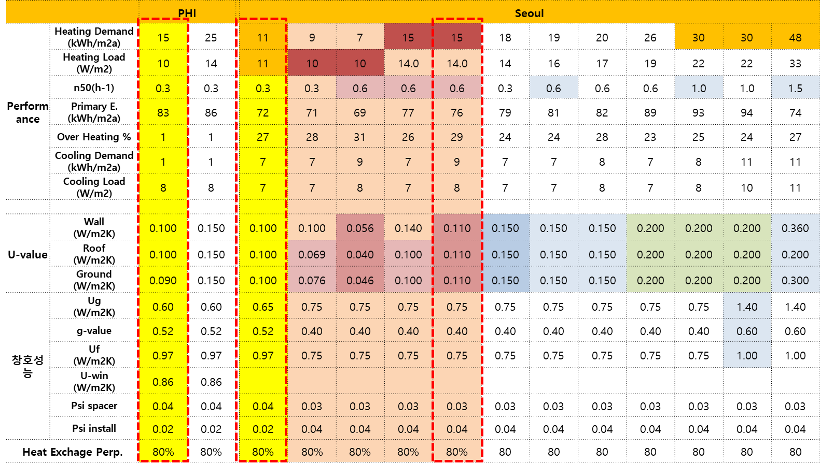
Localization of passive house - climate
Case Study of 1.5L House
Compare the same building with central Germany and Seoul
A building with a performance of 1.5 liters in Germany was analyzed with a performance of 1.1 liters in Seoul.

Slide 19
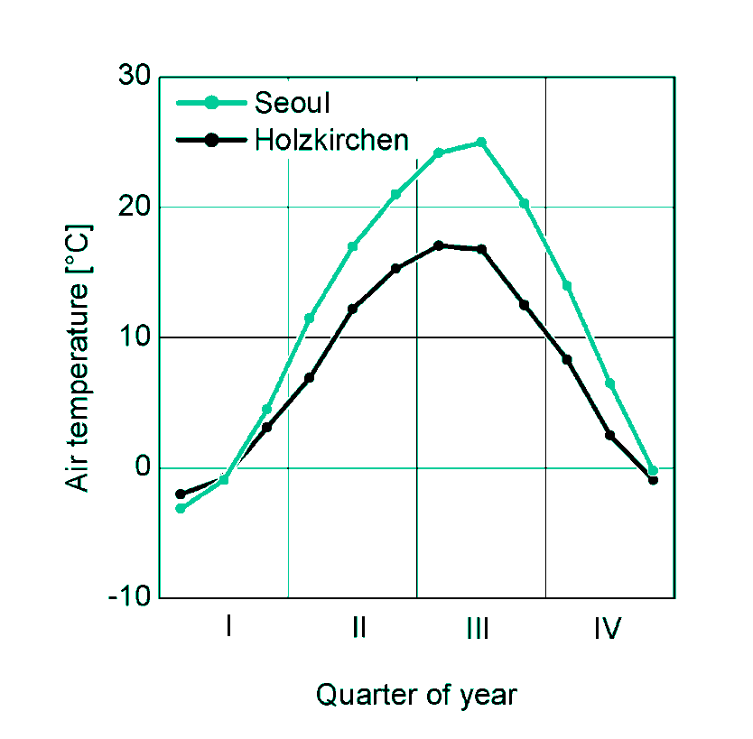
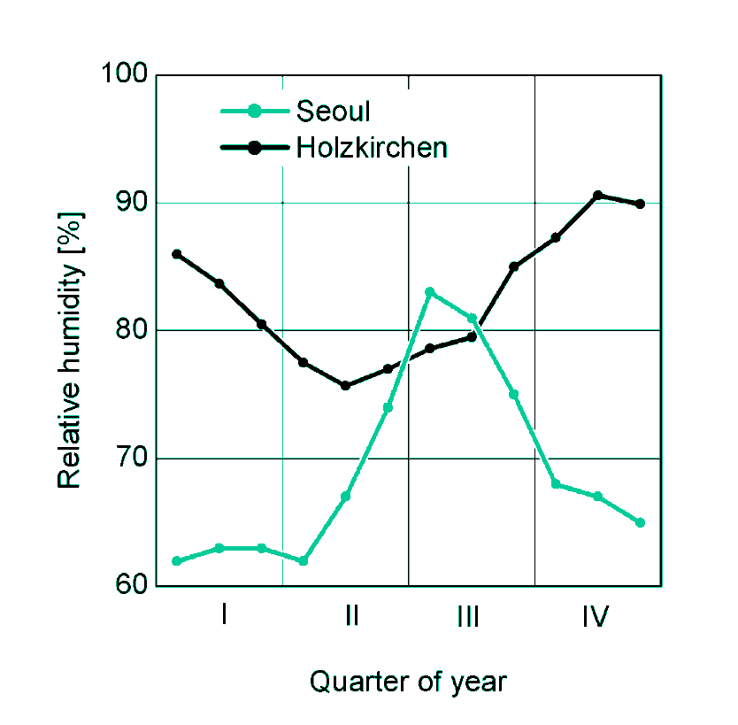
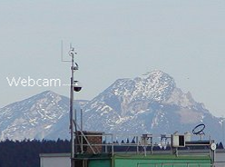
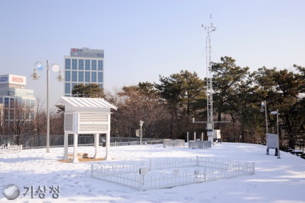

Localization of passive house - climate
Climate in Korea and Germany
Korea is colder in winter and hotter in summer
High humidity in summer, high discomfort index
IBP weather station
More Hot
More Humidity
Field test site in Holzkirchen
(alt.: 680 m, lat.: 48° N)
More Cold
Seoul (alt.: 20 m, lat.: 37° N)
=> More peak load
=> More mold risk

Slide 20
Localization of passive house - climate
Climate in Korea and Germany
2.5 times more winter solar energy than Germany
IBP weather station
Field test site in Holzkirchen
(alt.: 680 m, lat.: 48° N)
rainy season
Germany
Seoul (alt.: 20 m, lat.: 37° N)
Seoul
solar gain in winter
solar gain in winter

Slide 21
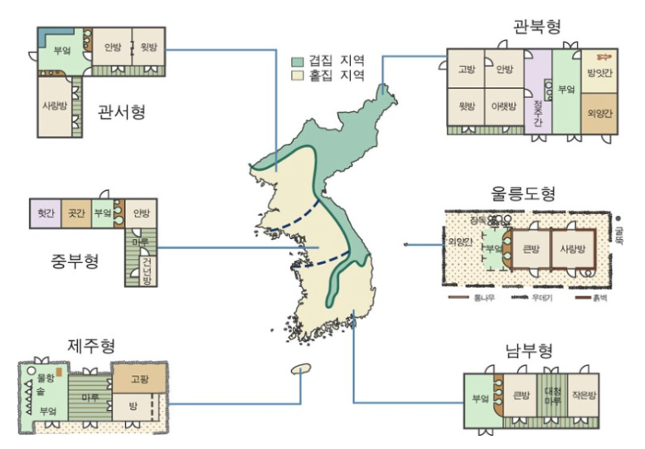
Localization of passive house - climate
Traditional Korean Architecture adapted to Regional Climatic Variations
Source: http://toytvstory.tistory.com/644

Slide 22
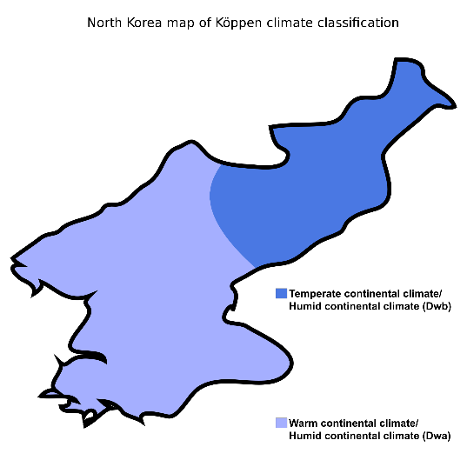
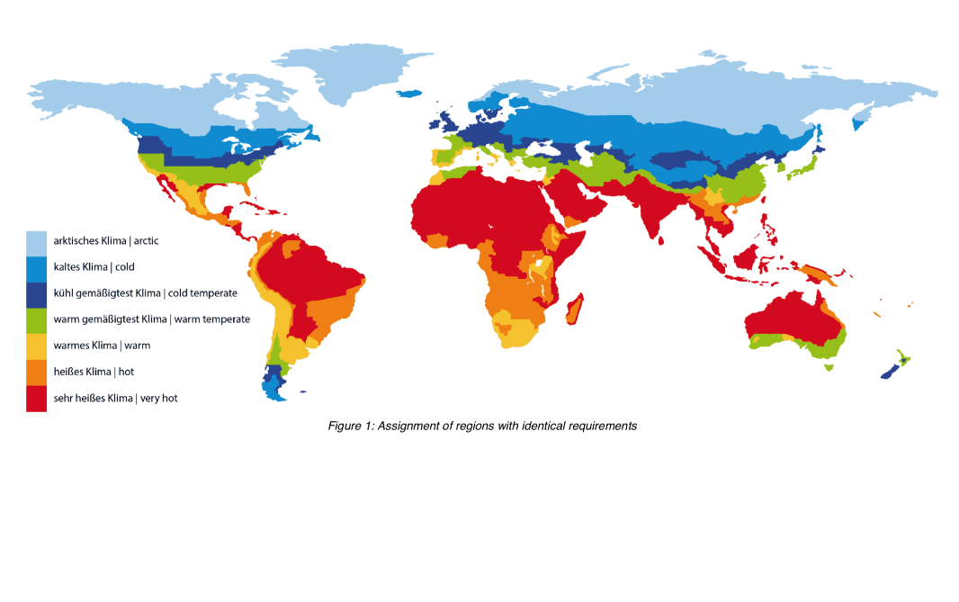
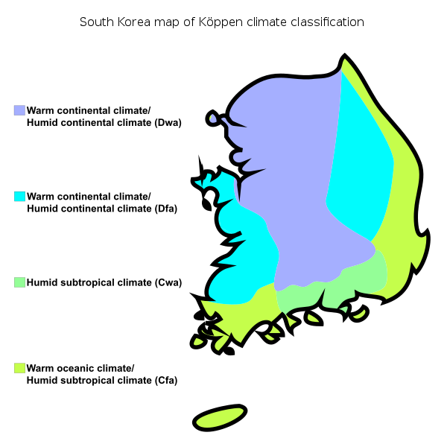
Localization of passive house - climate
Region of PHI and Köppen Climate Classification
✔
GERMANY = KOREA
WARM TEMPERATE CLIMATE
5 Types: Climate Classification
Source: PHI
Source: Köppen-Geiger vector by Ali Zifan

Slide 23
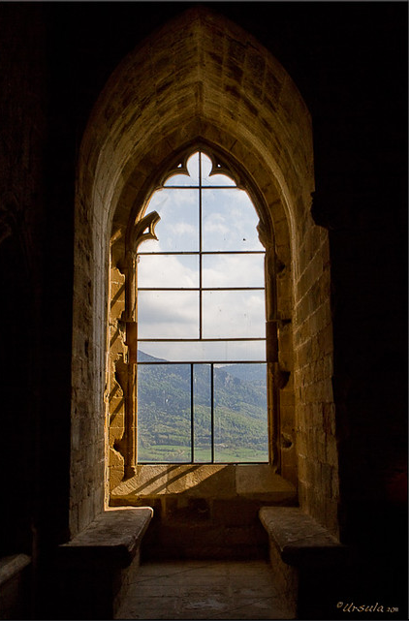
Localization of passive house - South Window
South Window

Slide 24
Localization of passive house - South Window
South solar radiation
Establishment of strategy to utilize abundant solar energy
IBP weather station
Field test site in Holzkirchen
(alt.: 680 m, lat.: 48° N)
rainy season
Germany
Seoul (alt.: 20 m, lat.: 37° N)
Seoul
solar gain in winter
solar gain in winter

Slide 25
Localization of passive house - South Window
Case study of south window percent
Comparison of performance by adjusting the area of ​​the south window for 10 certified buildings
case | 1 | 2 | 3 | 4 | 5 | 6 | 7 | 8 | 9 | 10 | mean
Heat Demand (L) | 2.9 | 3.1 | 3.0 | 2.8 | 2.6 | 2.9 | 3.0 | 2.9 | 2.9 | 3.2 | 2.93
S. Window area | 20.22 | 10.81 | 19.88 | 23.46 | 15.51 | 14.92 | 19.50 | 21.42 | 9.26 | 12.42 | 16.74
S. wall area | 94.28 | 50.85 | 152.72 | 103.88 | 60.65 | 68.11 | 70.61 | 83.87 | 40.69 | 42.96 | 76.86
S. Window % | 21.4% | 21.3% | 13.0% | 22.6% | 25.6% | 21.9% | 27.6% | 25.5.% | 22.8% | 28.9% | 23.1%

Slide 26
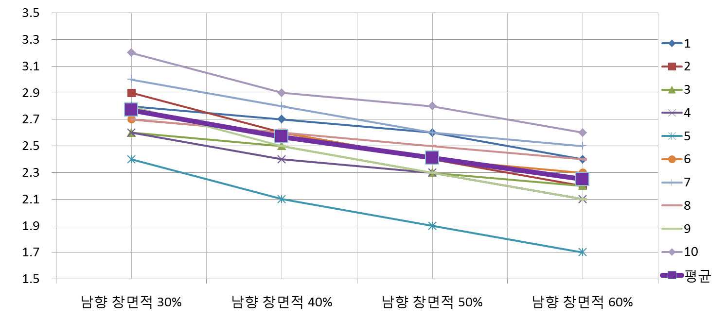
Localization of passive house - South Window
heating demand according to south window percent
It can be seen that the heating energy performance improves as the area of ​​the south window increases.
(case)
(L)
S. Window 30%
S. Window 40%
S. Window 50%
S. Window 60%

Slide 27
Localization of passive house - SHGC (g-value)
heating demand according to g-value
It has the same effect of reducing heat demand with a lower g-value compared to Germany.
- Middle of EU
- Seoul
g-값 : 0.20
g-값 : 0.25
g-값 : 0.30
g-값 : 0.20
g-값 : 0.35
1.8L
g-값 : 0.40
g-값 : 0.25
g-값 : 0.45
g-값 : 0.30
g-값 : 0.50
g-값 : 0.35
g-값 : 0.40
2.5L
g-값 : 0.45
g-값 : 0.50

Slide 28

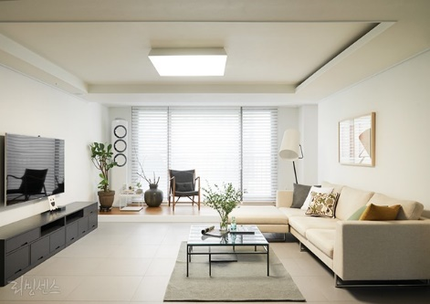
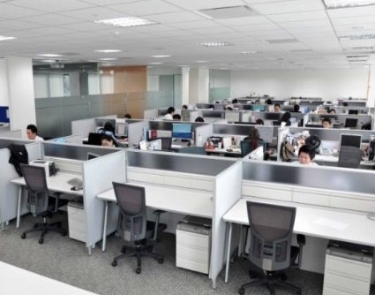
Localization of passive house - SHGC (g-value)
Adjust g-value according to energy consumption pattern
Residential facilities receive a lot of solar energy to reduce heating energy, and non-residential facilities block solar energy to reduce cooling load.
Residential buildings
Energy Consumption
Non-Residential buildings
Energy Consumption
heating
cooling
heating
cooling
Low Internal Heat Gain
Large Internal Heat Gain

Slide 29
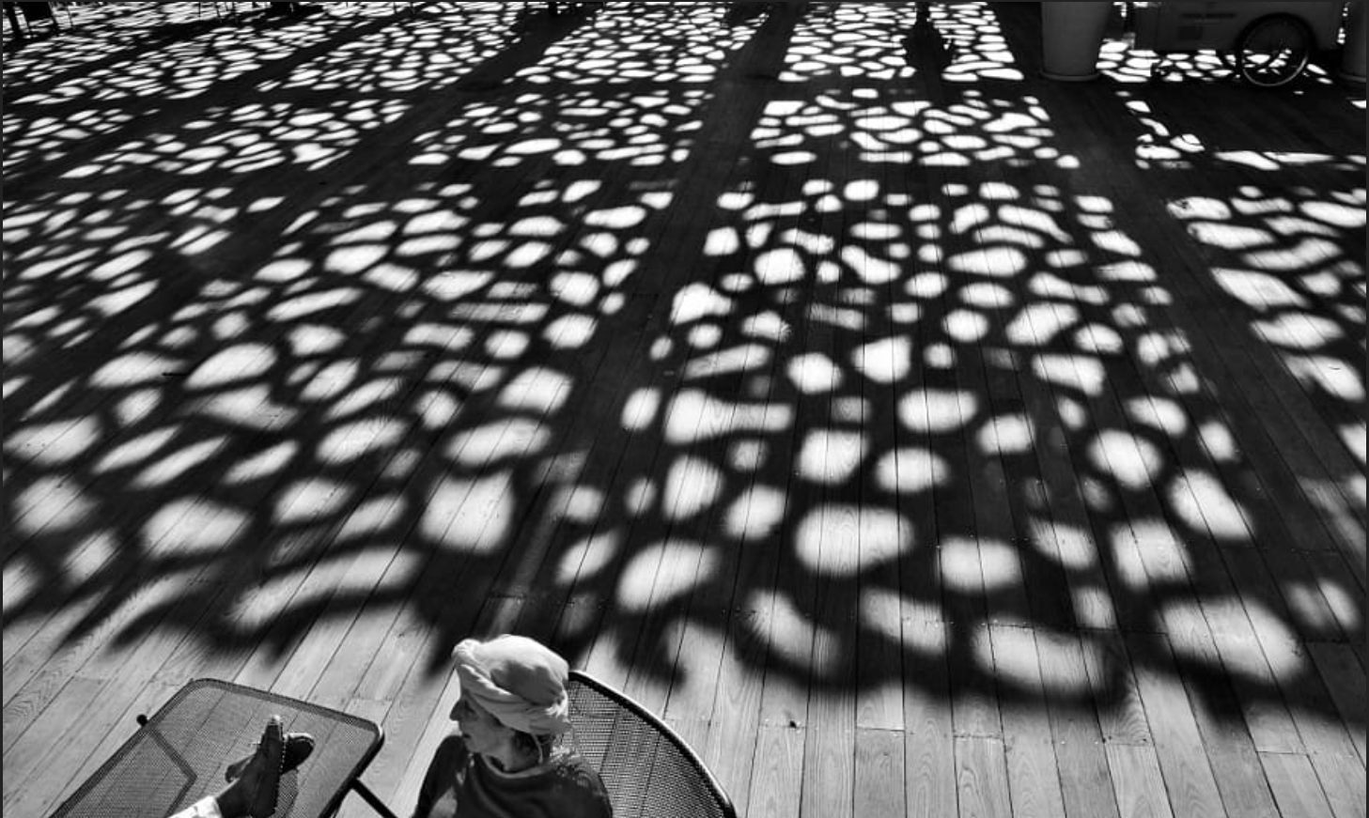
Localization of passive house - Shading
Shading

Slide 30
Localization of passive house - Shading
Necessity of Shade
Since the temperature and humidity are higher than in Germany, it is necessary to reduce the cooling load by actively blocking solar radiation.
- South solar radiation
- Outdoor temperature
More Hot
More Humidity
Germany
Seoul

Slide 31
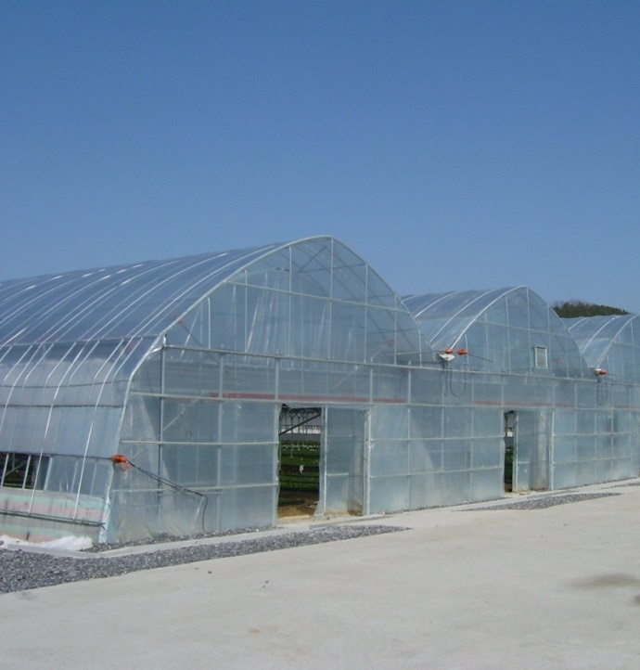
Localization of passive house - Shading
The need for an external awning
Short-wave solar energy that enters through the transparent building material turns into a long-wave and heats the inside.
Short wave
long wave

Slide 32
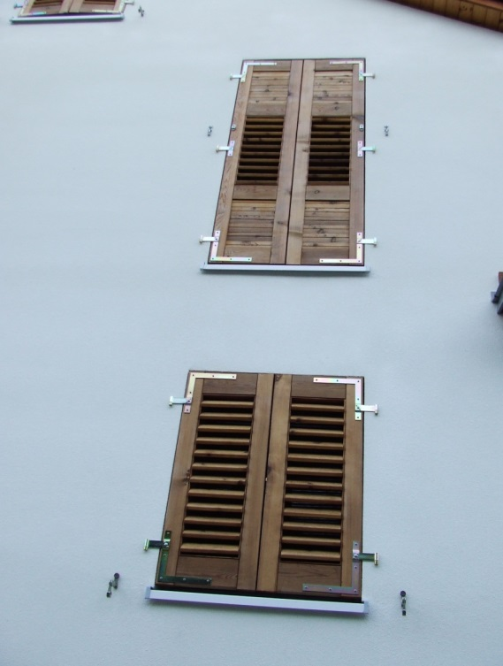
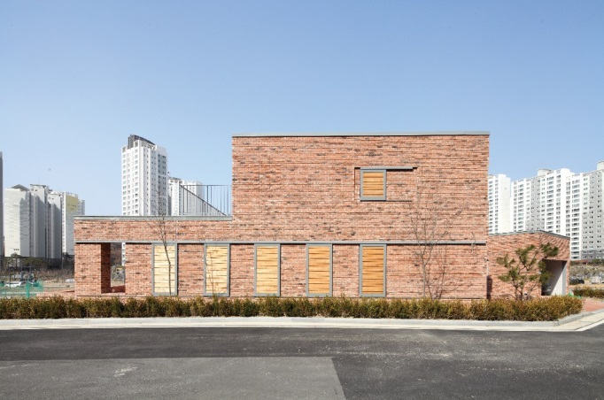
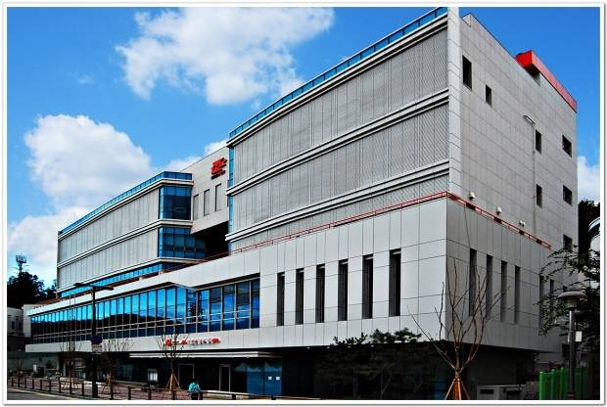
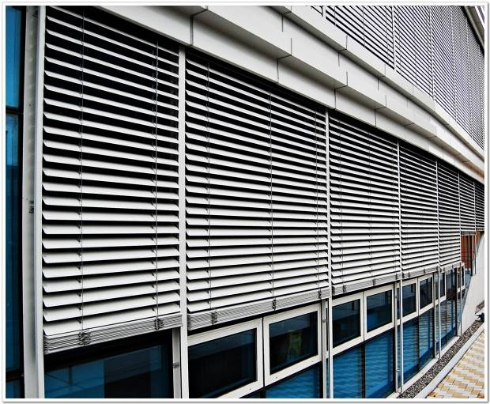
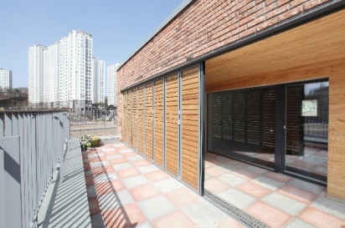
Localization of passive house - Shading
Various type of shading
There are sun protection devices of various materials.
A shading device considering the design of the building should be planned from the beginning of the design.

Slide 33
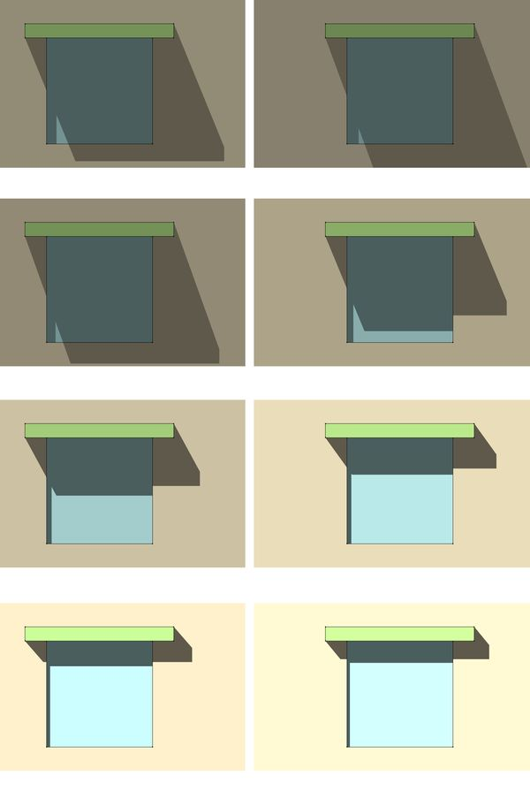
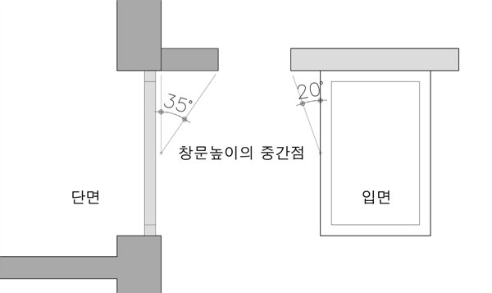
Localization of passive house - Shading
Fixed awning plan
Draw a line with the latitude of the area based on the center of the glass.
Extrude the structure close to the line.
Shadow at 2pm on the 15th of each month
May
June
latitude
July
August
center of the glass
September
October
November
December

Slide 34

Localization of passive house – Envelope U-value
Envelope U-value

Slide 35
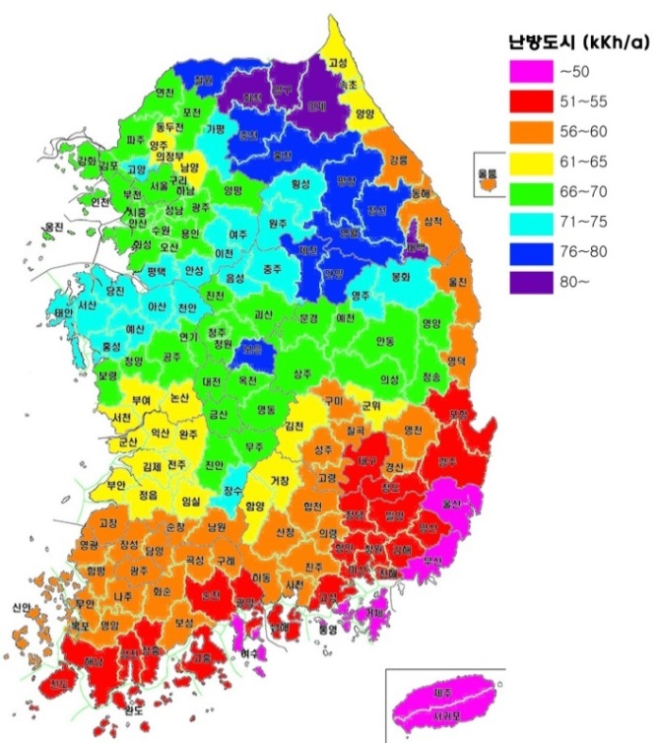
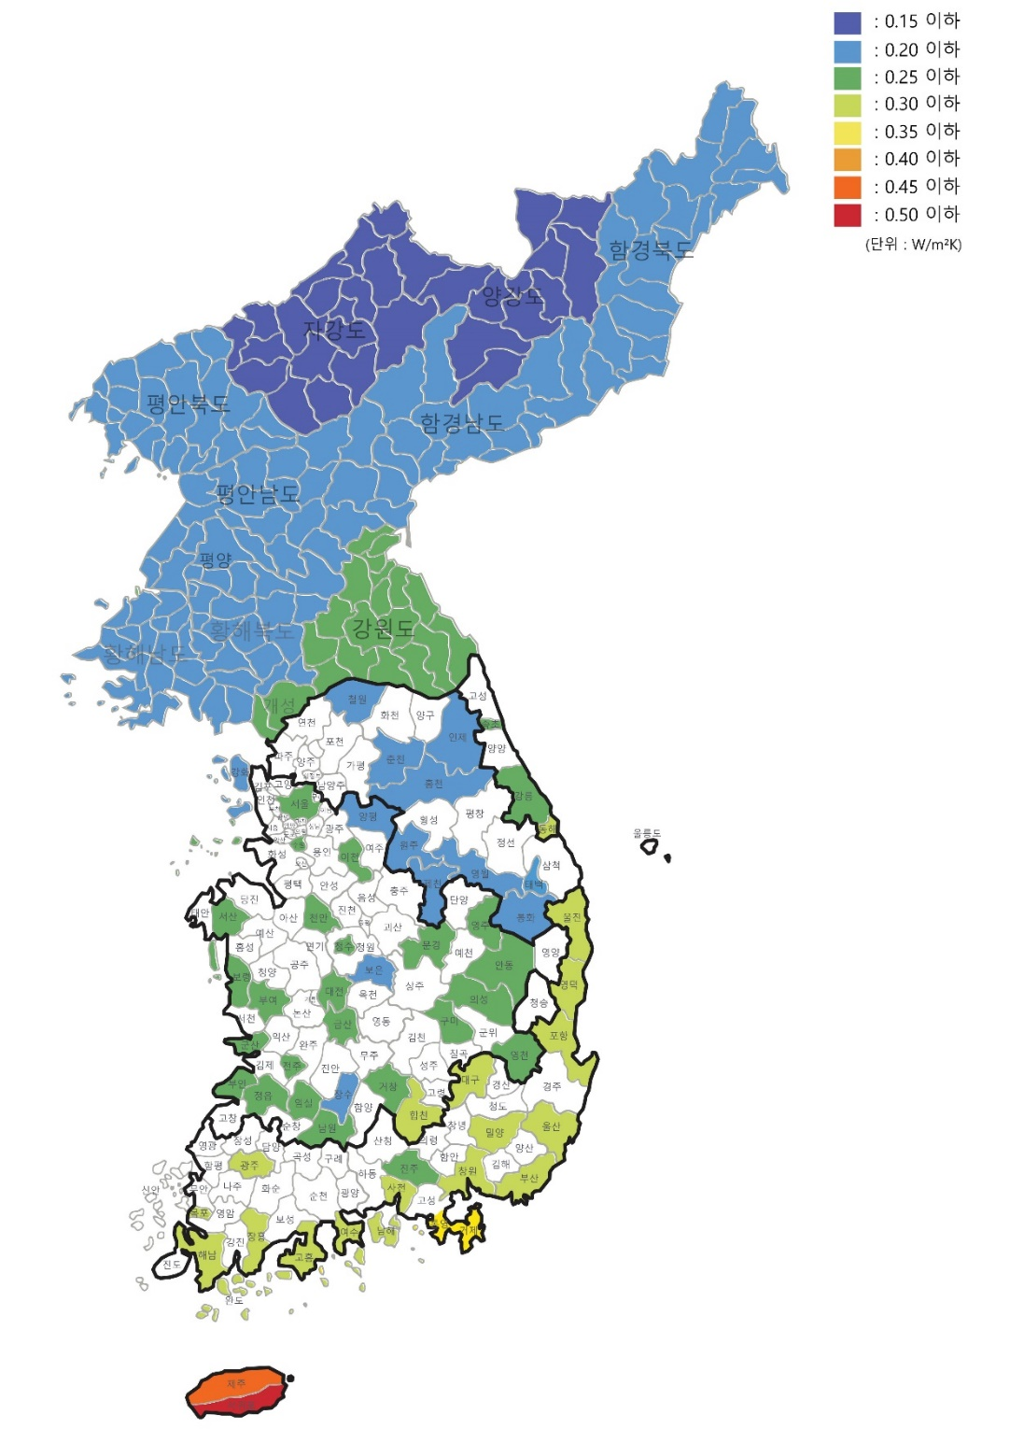
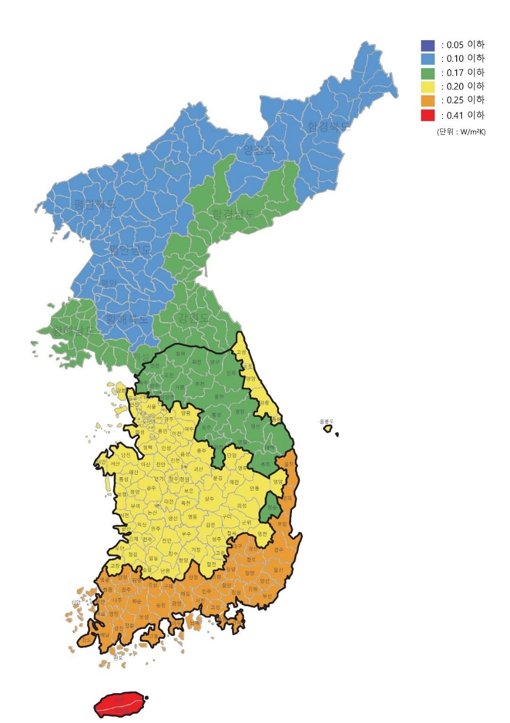


Localization of passive house – Envelope U-value
Exterior wall insulation standards based on climate data
Insulation performance analysis to prevent condensation mold in the corner of the exterior wall
- Heat Degree Hours in South Korea
- current law and Organized by region

Slide 36
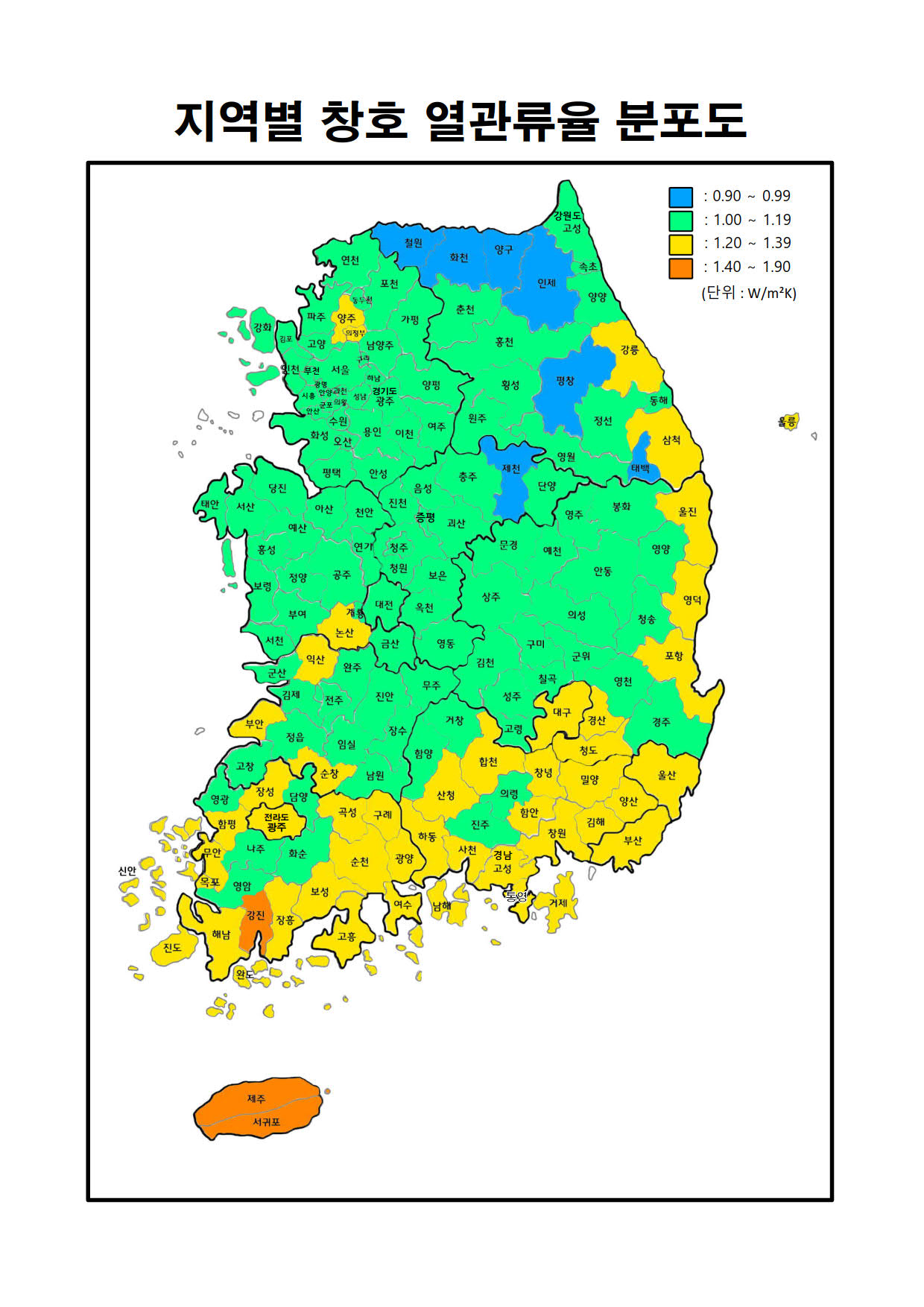
Localization of passive house – Envelope U-value
Window Performance by Climate
The temperature difference between the inner wall and the window surface is 3K or less
Conditions under which cold drafts do not occur around windows
Conditions that do not generate cold drafts based on the coldest 12-hour winter temperature interval Uw = 4.2K / [1.1(m²K/W) X (22℃ - Ext. Temp.)]
(W/㎡K)
Radiation temperature difference < 3K
Height 1.1m
The coldest 12-hour
average temperature
Temperature difference must be smaller than 2K – cold feet
Height 0.1m

Slide 37
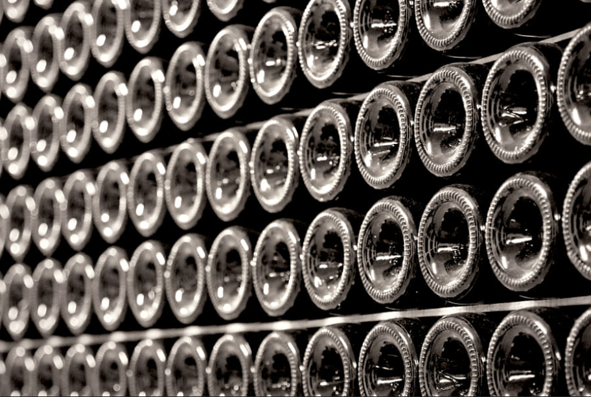
Localization of passive house – Thermal Storage
Thermal Storage

Slide 38
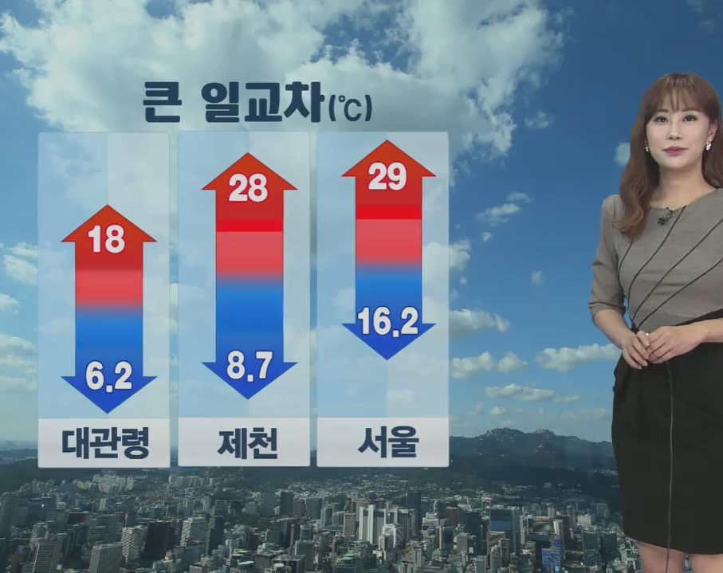

Localization of passive house – Thermal Storage
Large temperature differences between day and night
Due to the large temperature difference between day and night, it is necessary to plan for facility response capability and comfort level management.
-270.45 °C
+ 15 °C

Slide 39
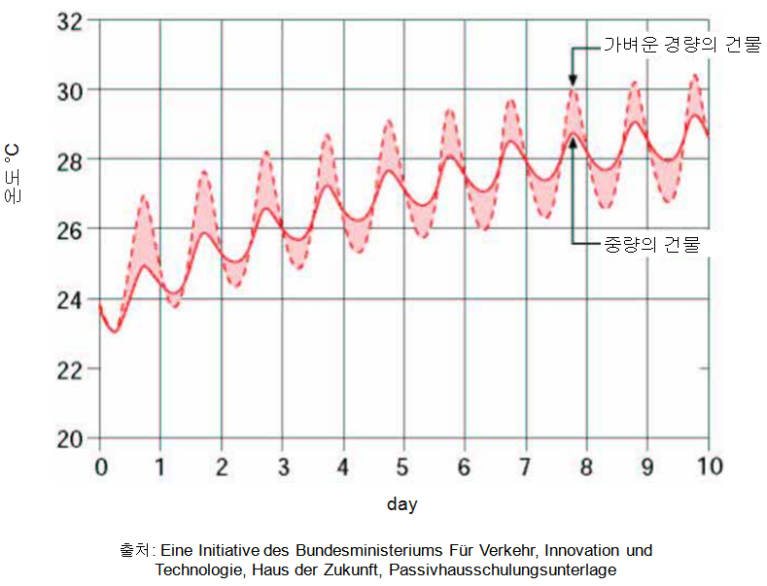
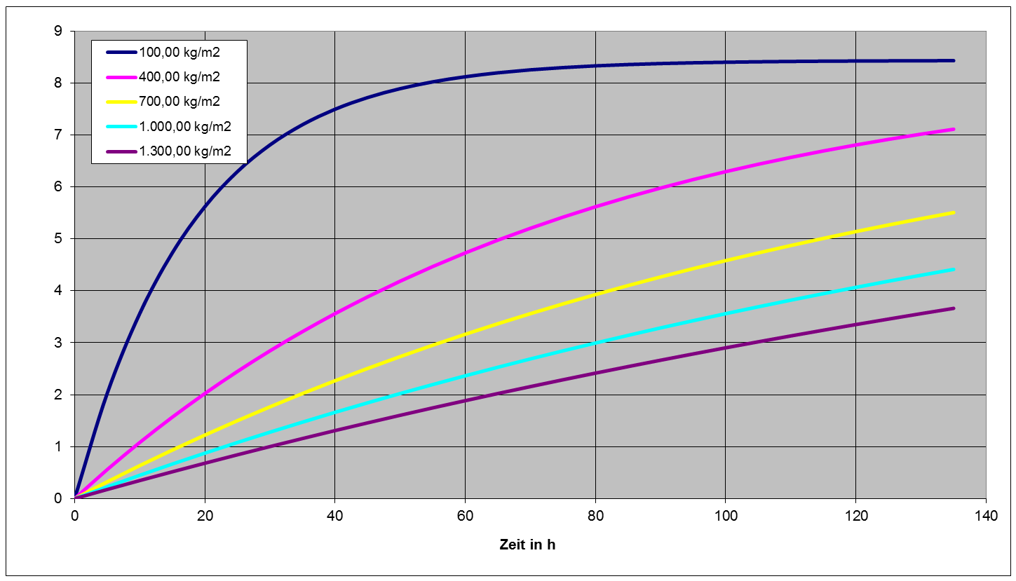
Localization of passive house – Thermal Storage
Effect of heat storage performance
By using the thermal storage performance, it is possible to prevent the indoor temperature from changing rapidly when the outside temperature changes greatly.

Slide 40
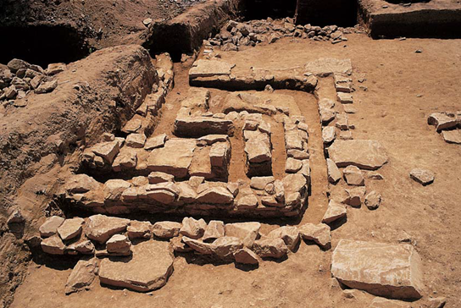
Localization of passive house – lifestyle
Lifestyle

Slide 41

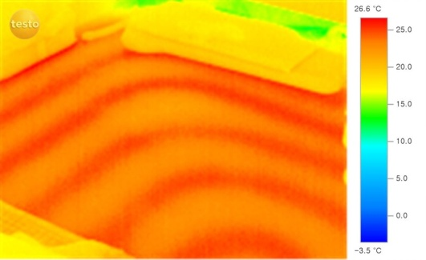
Localization of passive house – lifestyle
Different lifestyle
The floor heating method used in Korea for more than 1000 years is being applied to residential facilities in a modified form in modern architecture.

Slide 42
Localization of passive house – lifestyle
Criteria suitable for local residential culture
In early days of Korean passivehouse, heat is stored in mortal with high-temperature boiler. And it got worse when it release its heat during morning, the time when it starts to obtain solar radiation. It cause an overheating and people tend to open the window because of it.
Heating
Energy
demand
210 kWh/㎡a
50 kWh/㎡a
Korea
15 kWh/㎡a
PHI Standard
Building performance (Calculated value), kWh/㎡a

Slide 43
Localization of passive house – lifestyle
Passive House standard in PHIKO
 |  | German | Korea
U-value | Ex. Wall | 0.15 W/㎡·K | 0.15 ~ 0.18 W/㎡·K
 | roof | 0.15 W/㎡·K | 0.12 ~ 0.15 W/㎡·K
 | U-glass | 0.8 W/㎡·K | 0.9 ~ 1.4 W/㎡·K
 | U-frame | 0.8 W/㎡·K | 0.8 ~ 1.4 W/㎡·K
 | U-window | 0.85 W/㎡·K | 0.9 ~ 1.5 W/㎡·K
 | door | 0.8 W/㎡·K | 1.2 W/㎡·K
g-value | glass g-value (SHGC) | 0.5 | 0.4
Heat Exchanger | Efficiency | 75% | 75%
 | Power Consumption | 0.45 W/㎥h | 0.50 W/㎥h
Performance | Air tightness | 0.6 /h @ 50Pa | 1.0 /h @ 50Pa
 | Heating Demand | 15 kWh/㎡a | 50 kWh/㎡a
 | primary energy consumtion | 120 kWh/㎡a | 150 kWh/㎡a

Slide 44
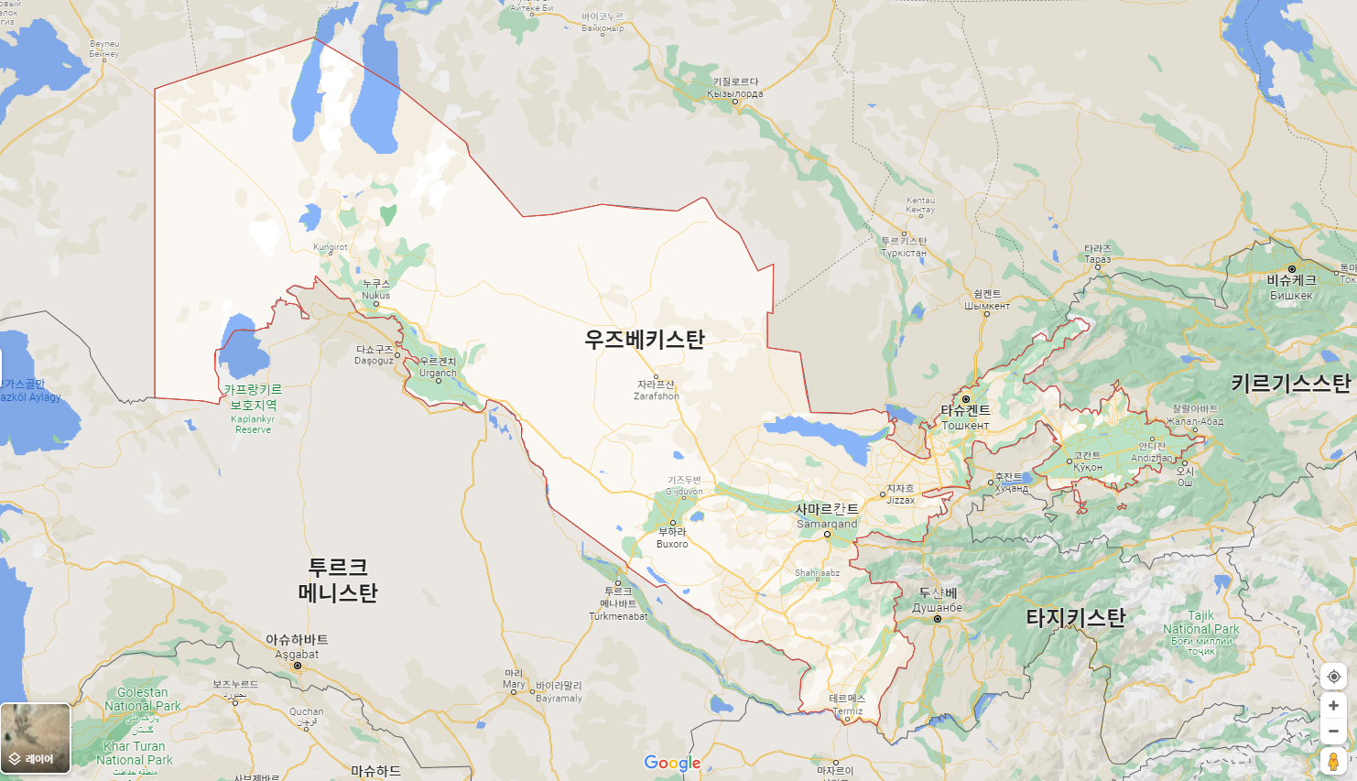

Localization of passive house

Slide 45
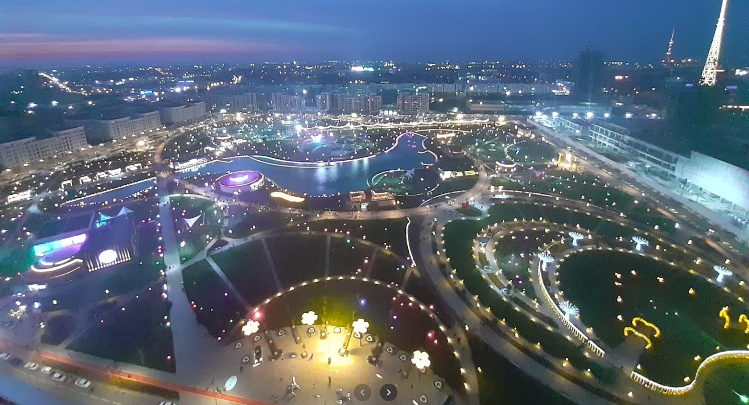
Localization of passive house
Tashkent City Park

Slide 46
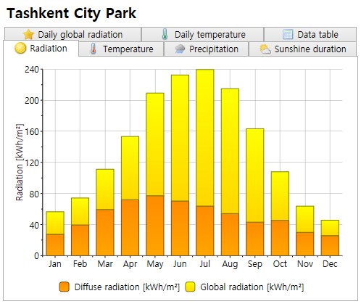
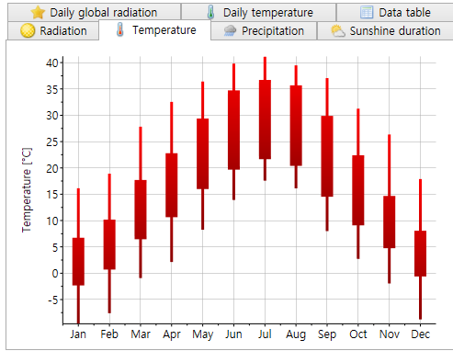
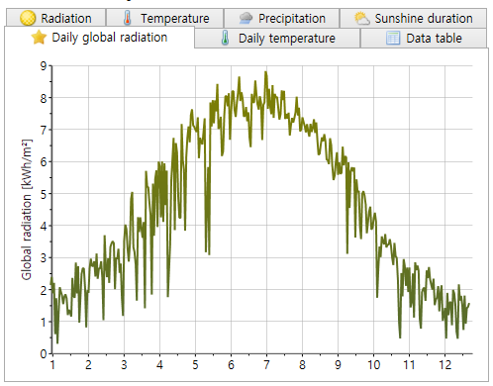
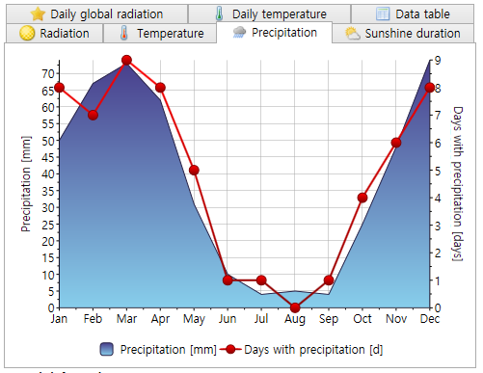
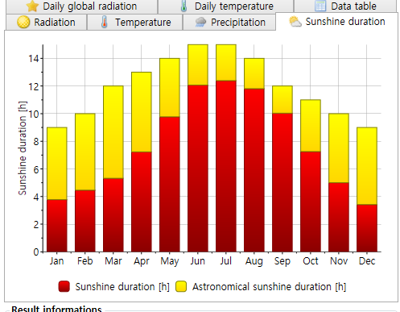

Localization of passive house
Tashkent City Park – climate data

Slide 47



Localization of passive house
Heating demand Seoul & Tashkent City Park
The same building was compared by applying the climates of Seoul and Tashkent.
Seoul
Tashkent City Park
27.06
kWh/㎡a
21.59
kWh/㎡a

Slide 48

Zero Energy Building - EDC

Slide 49



Zero Energy Building - EDC
solar power panel
45.7 kW
57.4kW
88.92kW
- Detached house energy self-sufficiency rate 109%
- Public Relations Hall Housing Energy Self-Reliance Rate171%

Slide 50

Zero Energy Building - EDC
Geothermal source heat pump system & Water source heat pump system

Slide 51





Zero Energy Building - EDC
Geothermal source heat pump system & Water source heat pump system

Slide 52

Zero Energy Building - EDC
Energy sharing platform development and business model development

